Slide 1

Movies!
Project 1: Group 11
Crimson amaro
Chanelle gonzalez
Irfan Senyurt
Jing sy
Matthew reyes
Jared Perez
Vinayak Shankar
Image source: https://www.imdb.com/title/tt4154796/

Slide 2
Our topic
American Movie Trends Before and After COVID-19

Slide 3


Why we chose this topic
Image sources:
https://4hatsandfrugal.com/2018/04/avengers-infinity-war-review-parent-honest-opinion.html
https://variety.com/2015/digital/news/roku-chromecast-apple-tv-fire-tv-best-netflix-streamer-1201650291/

Slide 4
Hypotheses
H₀: COVID-19 did not affect American movie trends.
H_{a}: COVID-19 did affect American movie trends.

Slide 5
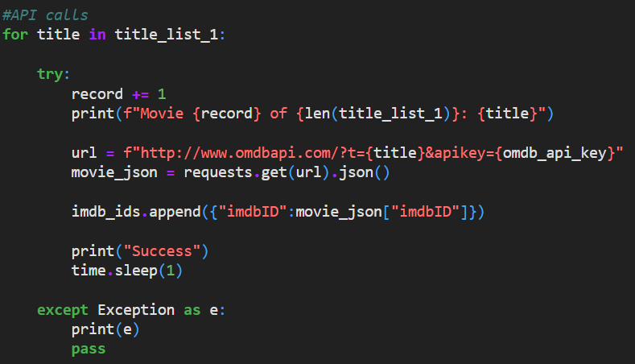
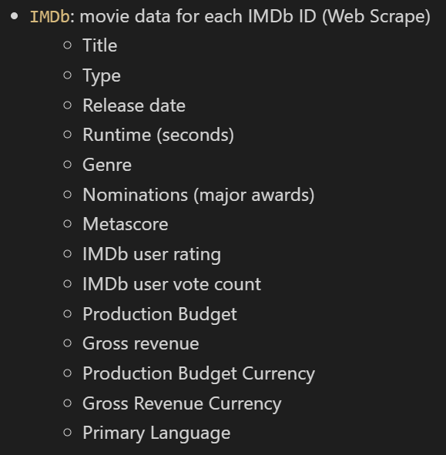
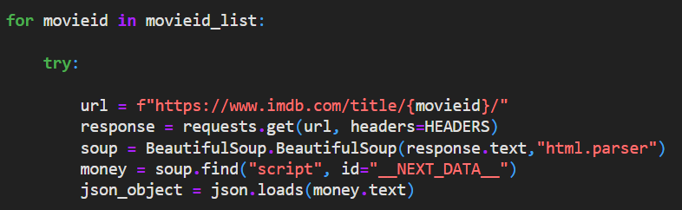
How we got the data
Wikipedia CSVs
Movie Titles
OMDb API
IMDb ID
IMDb HTML Scrape
Data

Slide 6
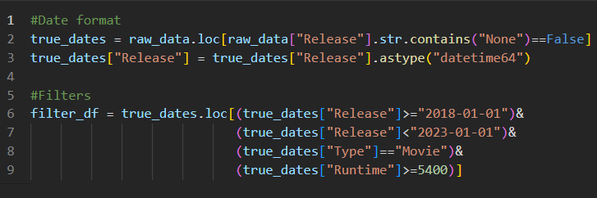

How we cleaned the data
Invalid Dates
Formats
Filters
Merges
Duplicates

Slide 7
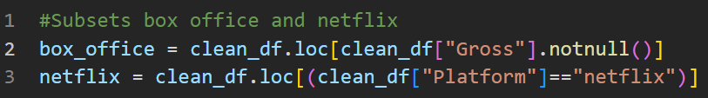
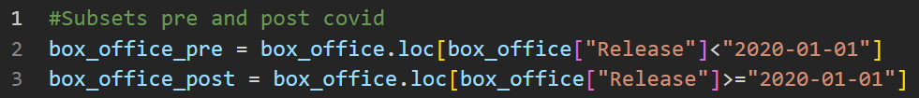
Definitions
BoxOffice
Gross != NaN
Pre COVID-19
2018 - 2019
Netflix
Platform = “netflix”
Post COVID-19
2020 - 2022

Slide 8
Up next: How we analyzed The DATA

Slide 9
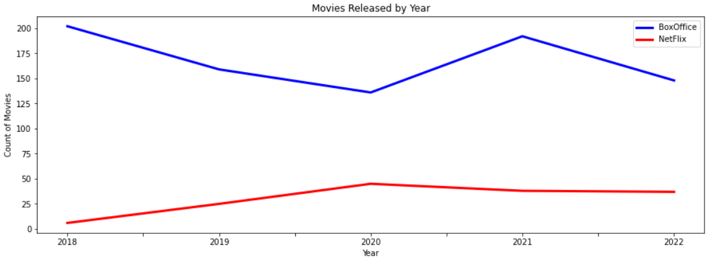
did covid affect the number of movies released?
Short answer:
BoxOffice - Immediately, YES, it declined, but it rebounded quickly.
The long term effects remain to be seen…
Netflix - NO real change shows as a direct result of COVID.
Notes:
Long Answer
Box Office: We definitely noticed a decline for 2020, during the peak of the shut down, which was expected. Though, there was still a lot more movies released than I expected to see. It seems to have bounced back quickly in 2021. Perhaps this is from movies that had been completed in 2020, but the release was held until 2021. However, to really understand any true long term impact, we would need more historical data to establish a pattern before COVID, as it looks like 2019 already saw a decrease.
Netflix: It appears that Netflix was already on the rise in 2019, and actually seemed to peak in 2020 and plateau with a slight decline in the years after COVID. I was surprised by this given the amount of us streaming now. It seems like we have more options to choose from than ever before at home, but there are is a lot more competition coming up in the streaming world with Hulu and Disney+.

Slide 10
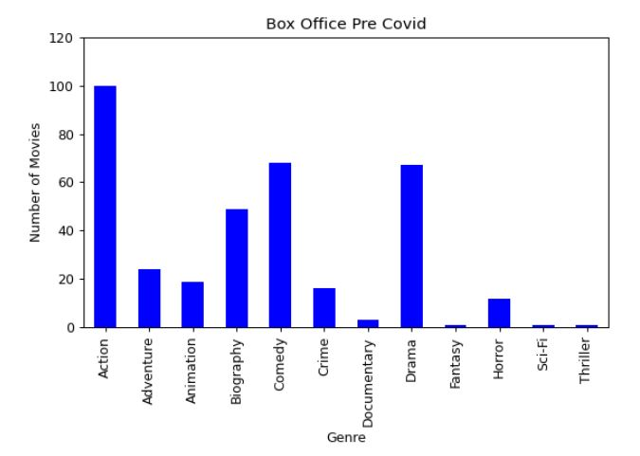
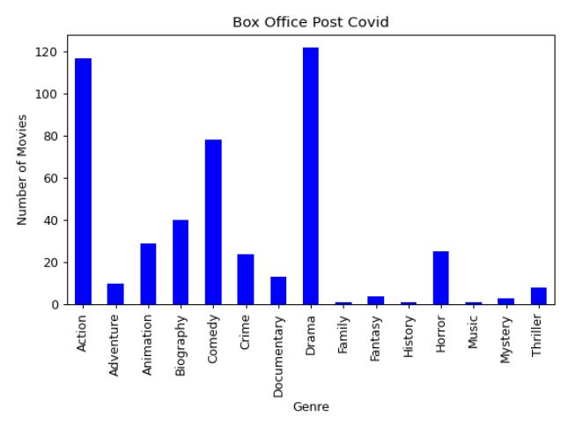
did covid affect the number of movies per genre?
*Note: only the first genre was recorded for movies with multiple genres
Notes:
First let’s look at the years as a whole:
Box Office: The box office’s most popular genres are very clear, Action, Drama and Comedy.

Slide 11
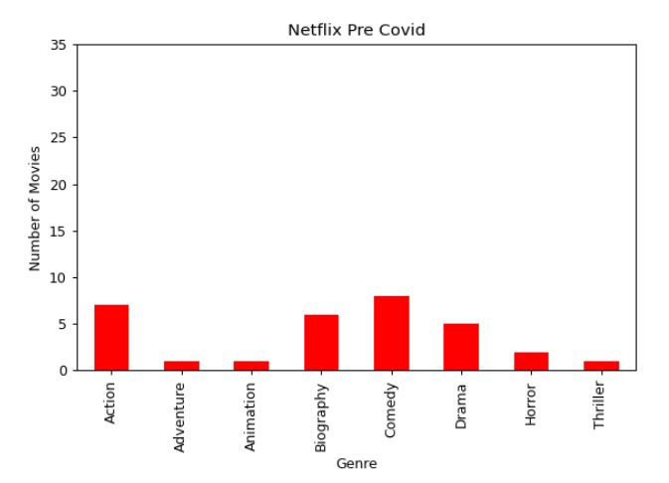
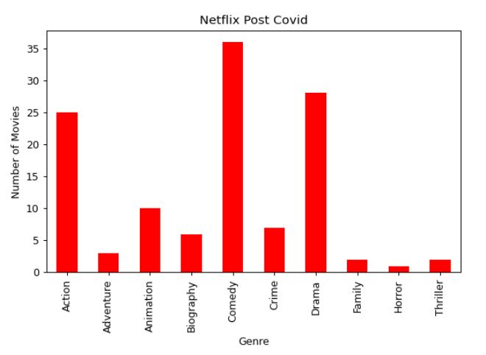
did covid affect the number of movies per genre?
Notes:
Netflix: Must be something to that, as Netflix follows a similar model, but with a slightly different order. They released just a slightly larger amount of Comedy movies, but Action and Drama are not far behind.

Slide 12
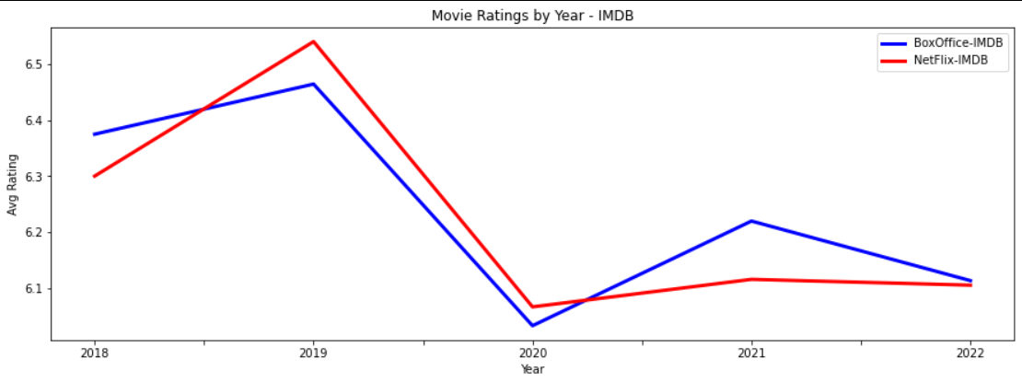
did covid affect the Ratings or quality of movies?
Short answer from IMDb voters:
BoxOffice - YES, voters aren’t quite as happy with the movies since COVID.
Netflix - YES, voters also feel that these movies aren’t as good as those that came before.
Notes:
Long Answer from IMDB
Box Office: Without more historical data, it is hard to know just how much this jumped around in the past, but from this subset, it does appear that folks aren’t enjoying movies quite as much as before the pandemic. However, if you look at the scale it is only a range of about 0.5 on average, so pretty nominal changes, really.
Netflix: This almost exact pattern continues with Netflix.

Slide 13
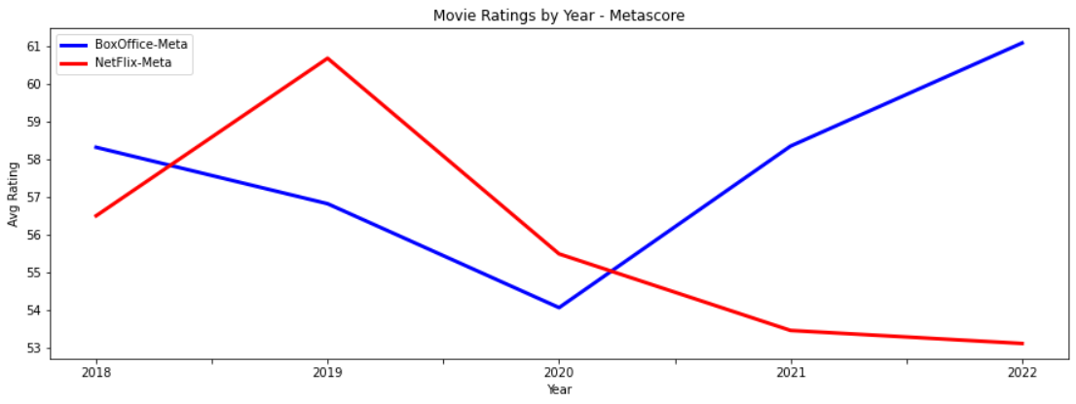
did covid affect the Ratings or quality of movies?
Short answer from Metacritic voters:
BoxOffice - YES, these voters are happy to be back in the theaters and watching good movies.
Netflix - YES, and it isn’t looking good for them. They aren’t getting any love from these voters.
Notes:
Long Answer from Metacritic
Box Office: Contrary to all others, these scores show that people are happy with they are seeing since going back into theaters than before we were locked out.
Netflix: Yikes. I thought this crash could be as a result of just churning out more movies of lesser quality, but as we saw before, they actually haven’t really been releasing more movies in this time frame, so perhaps they ran out of good ideas in 2019.
Final: Yes, COVID does look to have an effect on ratings. With the exception of some happier Metacritic voters, the overall ratings and quality of movies has declined since the pandemic.

Slide 14
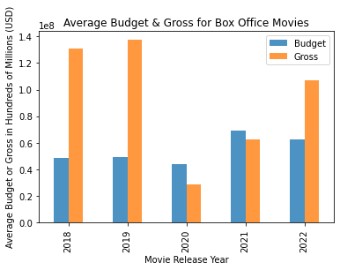
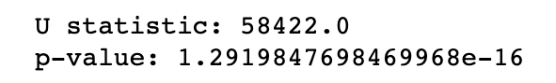
Did covid affect Annual Budget & Gross? (Box office)
Movie budget did not change much pre- and post-COVID
However, movie gross took a considerable hit with COVID, and is slowly getting back up post-COVID (p << 0.05)
COVID significantly and negatively impacted the movie gross
Pre-Covid
Post-Covid

Slide 15
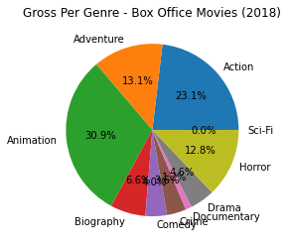
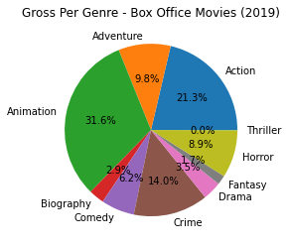
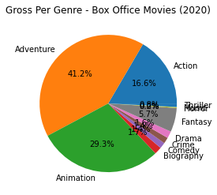
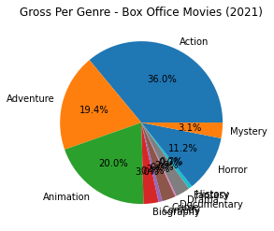
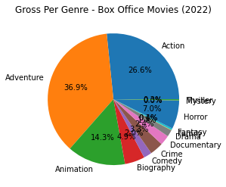
Did covid affect gross by genre? (Box Office Movies)
Movie genre saw substantial shift in gross distribution pre- & post-COVID
2018
2019
2020
2021
2022

Slide 16
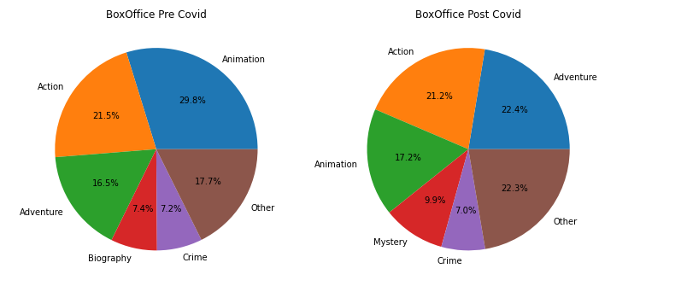
did covid affect genre budgets? (BOX OFFICE)

Slide 17
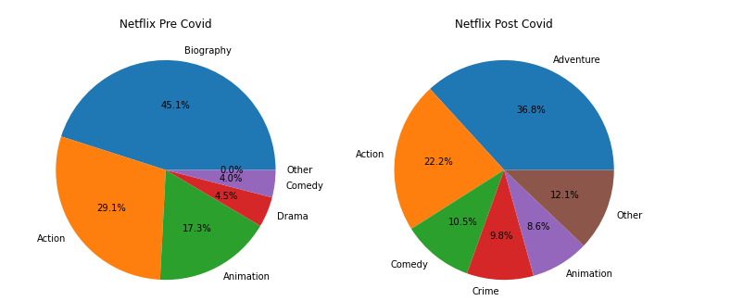
did covid affect GENRE BUDGETS? (Netflix)

Slide 18
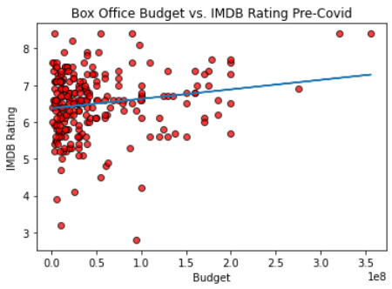
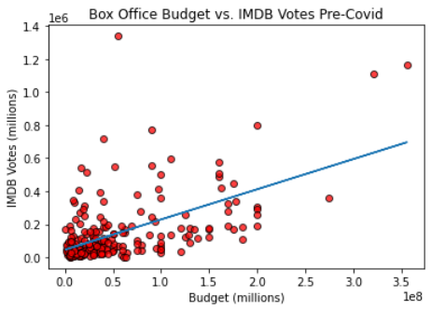
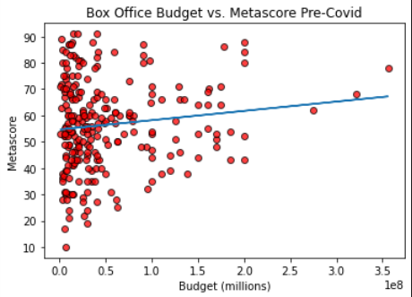
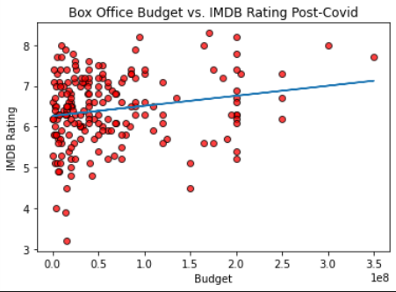
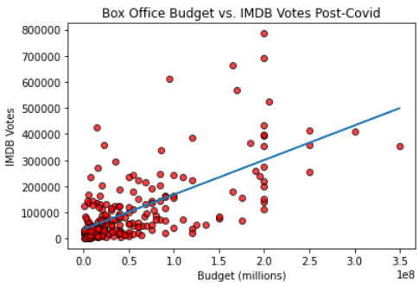
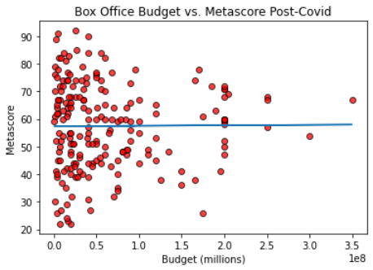
Did covid affect budget vs. rating? (Box office)
IMDB Ratings represent popular opinion based on individual votes
We see a decrease in number of movies (243 vs 199) but not in budget
Positive correlation
IMDB Votes represent popularity (viewership) of movies
We see a decrease in number of movies (243 vs 199) and votes
Positive correlation
Metascores represent the weighted average of reviews
We see a decrease in number of movies (243 vs 199) and ratings
Positive to zero correlation

Slide 19
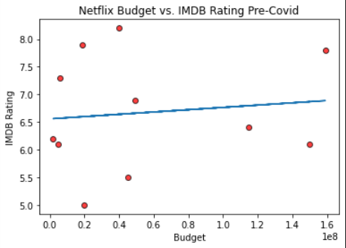
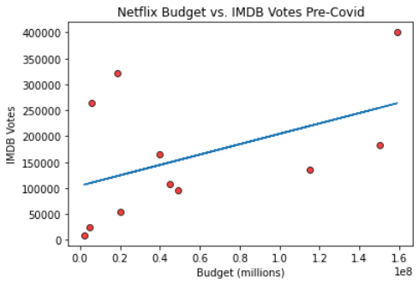
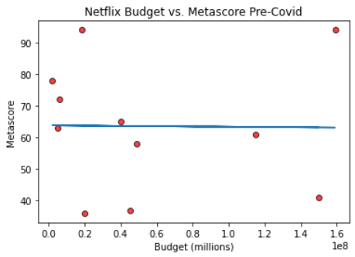
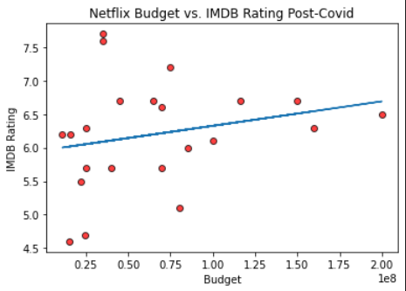
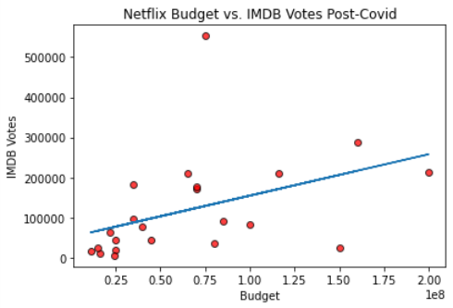
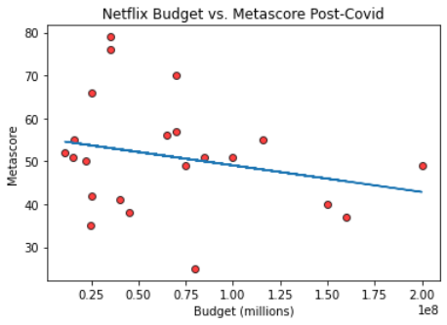
Did covid affect budget vs. rating? (netflix)
IMDB Ratings represent popular opinion based on individual votes
We see an increase in number of movies (11 vs 22) as well as overall budget
Positive correlation
IMDB votes represent popularity (viewership) of movies
We see an increase in number of movies (11 vs 22) and votes
Positive correlation
Metascores represent the weighted average of reviews
While budget has increased, overall metascore has declined significantly.
None to negative correlation

Slide 20
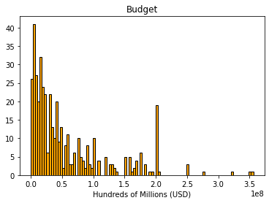
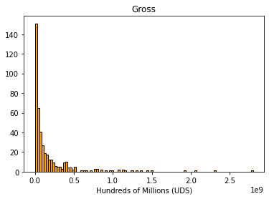
Is the dataset normally distributed?

Slide 21
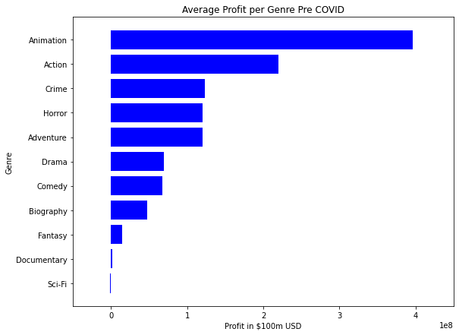
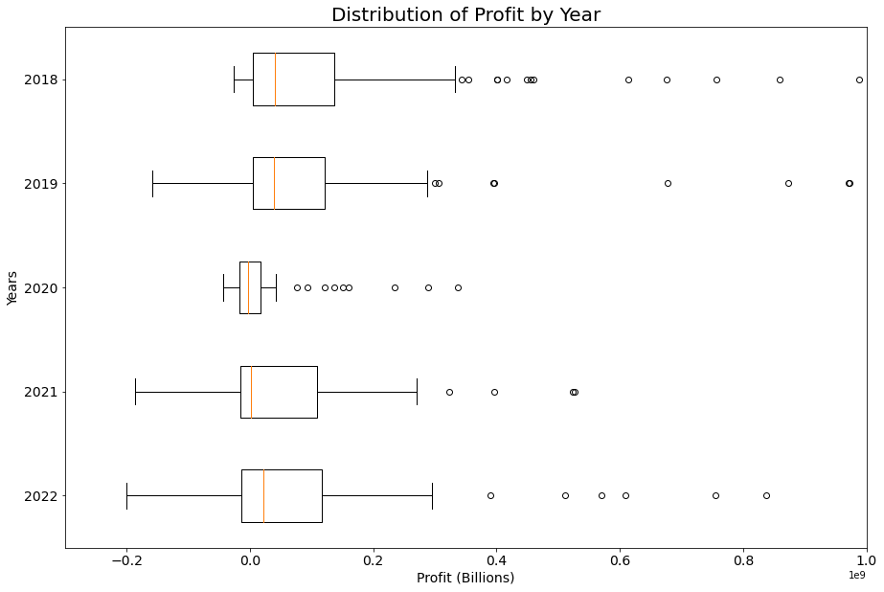
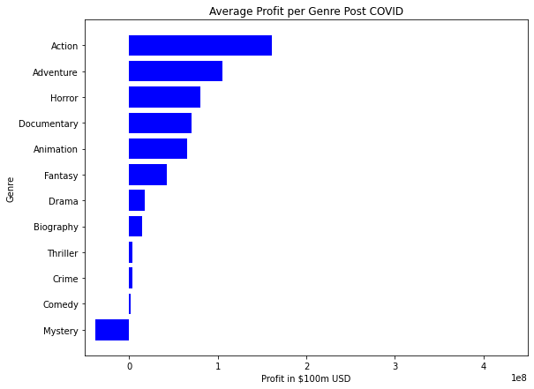
Did covid affect profit?
Profit =
Gross – Budget

Slide 22
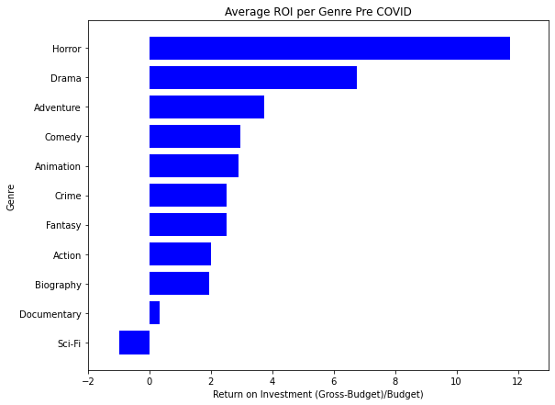
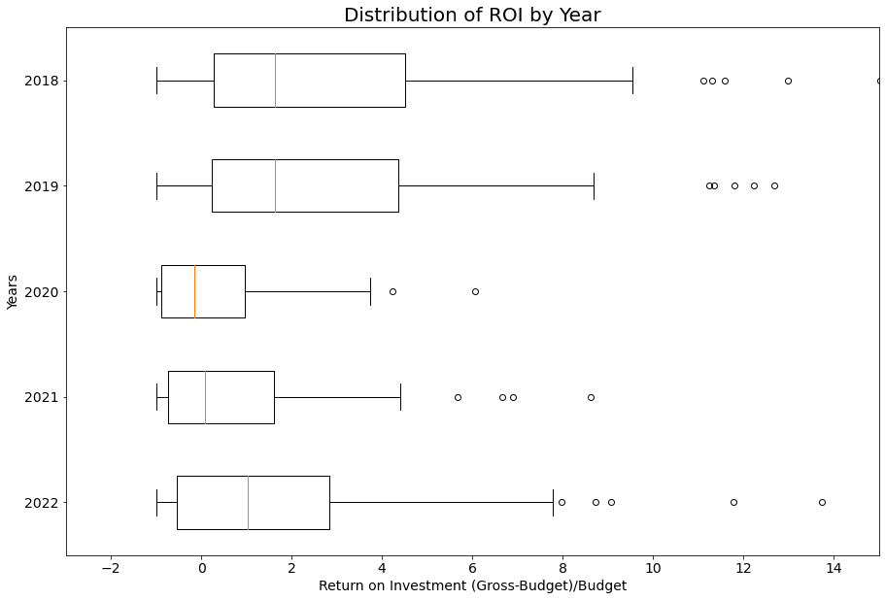
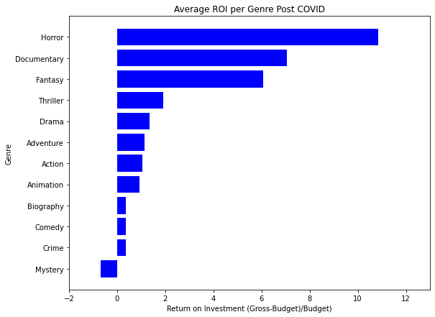
Did covid affect ROI?
ROI =
(Gross – Budget) / Budget

Slide 23
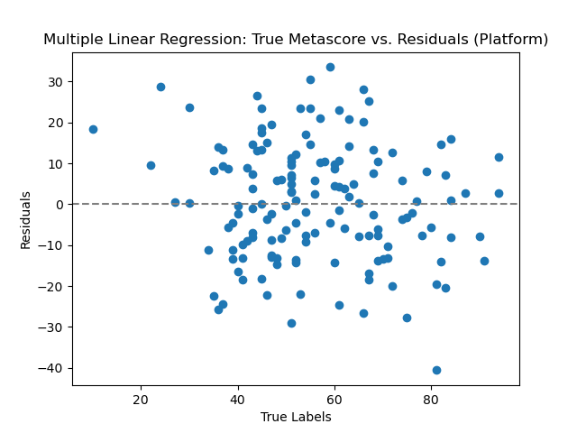
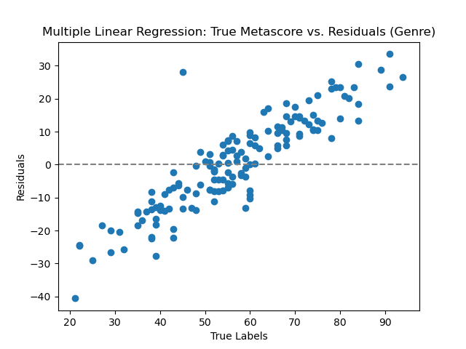
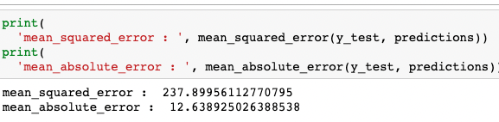
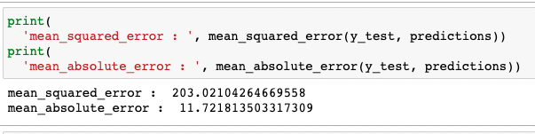
Multiple Linear Regression and MLPRegressor
Notes:
Model the relationships between multiple input features and a continuous output variable.
Aimed to predict Metascore rating from input features “Release,” “Runtime,” “Budget,” and either ”Genre” or ”Platform.”
MLPRegressor is NN technique that was frankly overkill for this data and produced the exact same MSE of 237. Also Metascore is technically not a continuous variable because the outputs could not take on any value between 0-100, it appeared that they could only take on integers so that is a limitation. Had to use…

Slide 24
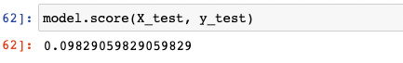

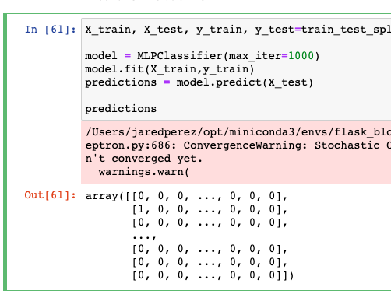
MLPClassifier to predict Movie Genre
Notes:
Piggy backing off of Vinny’s earlier analysis that Horror movies seemed to do well on ROI, I aimed to see if a model could predict movie genre based on Gross, Runtime, and Metascore (in hindsight, given the ROI statement I should have included budget but we lacked budget in a lot of movies and you need lots of data to run these NN model).

Slide 25
Conclusion
H₀: COVID-19 did not affect American movie trends.
REJECT
H_{a}: COVID-19 did affect American movie trends.

Slide 26
What’s next?
More Data (More movies, more years)
Better Data (Netflix)
Confounding variables (Runtime, Nominations, Multi-Genre films)

